Slide 1


Tahsine K. SALAMI
28/08/2024

Slide 2

Outline
Executive Summary
Introduction
Methodology
Results
Conclusion
Appendix

Slide 3
Executive Summary
Summary of methodologies:
Data Collection
Data Wrangling
EDA with Visualisation and SQL
Interactive visual analytics with Folium and Ploty Dash
Predictive analysis using classification models
Summary of all results:
Exploratory data analysis results
Interactive analytics demo
Predictive analysis results

Slide 4
Introduction
The commercial space age has arrived, marking a revolution in access to space. Today, companies like Virgin Galactic, Rocket Lab, Blue Origin, and especially SpaceX, are making space travel more affordable and accessible. Among these players, SpaceX stands out for its numerous achievements: sending machines to the International Space Station, development of the Starlink constellation to provide global Internet access, and manned missions in space.
One of the key factors in SpaceX's success lies in the drastic reduction in launch costs. While most space service providers charge more than $165 million per launch, SpaceX offers launches of its Falcon 9 rocket for just $62 million. This impressive savings is largely due to the reuse of the rockets' first stage.
In this context, accurately predicting whether a rocket's first stage will successfully land becomes crucial for estimating the cost of a launch. This is precisely the purpose of our project: to analyze SpaceX data to improve our understanding of these landings and thus refine the evaluation of the associated costs.

Slide 5

Section 1

Slide 6
Methodology
Executive Summary
Data collection methodology:
SpaceX API Rest
Wikipedia Web Scraping
Perform data wrangling
Perform exploratory data analysis (EDA) using visualization and SQL
Perform interactive visual analytics using Folium and Plotly Dash
Perform predictive analysis using classification models
Classification Model Development Process

Slide 7
Data Collection
The data collection process for the SpaceX Falcon 9 launch dataset involved two primary methods: API retrieval and web scraping.
By combining data from the SpaceX REST API with hisotical information from Wikipedia, we ensured a comprehensive dataset that captured all revelant aspects of the Falcon 9 launches.

Slide 8
Data Collection – SpaceX API
API Request : We utilized the SpaceX REST API to retrieve detailed information on Falcon 9 Launches,
Data Points: The API provided structured data, including launch dates, payload information, orbit details, launch outcomes, etc,
Automated Queries: Repeated automated queries were performed to fetch the latest data directly from the API
SpaceX API calls notebook : https://github.com/Tahsine/SpaceX-Capstone/blob/97105c195ca9cd7264a562e4c0a1bd581e933f9c/jupyter-labs-spacex-data-collection-api.ipynb
API Query
Response Data
Data Storage
Data Parsing

Slide 9
Data Collection - Scraping
Web Scraping: For additional details and historical data on Falcon 9, we implemented web scraping techniques,
Target Source: Wikipedia was selected for its comprehensive tables and consistent formatting related to SpaceX launches,
Data Extraction: HTML parsing was performed to extract tables containing all useful data
Wikipedia Scraping notebook : https://github.com/Tahsine/SpaceX-Capstone/blob/97105c195ca9cd7264a562e4c0a1bd581e933f9c/jupyter-labs-webscraping.ipynb
Wikipedia Page Access
HTML Parsing
Table Extraction

Slide 10
Data Wrangling
GitHub URL : https://github.com/Tahsine/SpaceX-Capstone/blob/97105c195ca9cd7264a562e4c0a1bd581e933f9c/labs-jupyter-spacex-Data%20wrangling.ipynb
Handling Missing Values
Launch Count by Site
Obit Analysis
Create Landing Success Indicator
Mission Outcome Evaluation

Slide 11
EDA with Data Visualization
For visualization, we used:
Scatter plot:
Allow us to explore the relationships between different continuous variables
Bar Chart
Is ideal for comparing success rates between different categories, here orbit types,
Line Chart
Is used to visualize trends over a period of time
GitHub URL : https://github.com/Tahsine/SpaceX-Capstone/blob/97105c195ca9cd7264a562e4c0a1bd581e933f9c/jupyter-labs-eda-dataviz.ipynb

Slide 12
EDA with SQL
SQL queries we used :
Created a table named SPACEXTABLE to store launch data.
Display queries
Query on successful landings
Query on specific boosters
Mission Statistics
Booster analysis:
Temporal query on landing failures
Ranking of landing results
GitHub URL : https://github.com/Tahsine/SpaceX-Capstone/blob/97105c195ca9cd7264a562e4c0a1bd581e933f9c/jupyter-labs-eda-sql-coursera_sqllite.ipynb

Slide 13
Build an Interactive Map with Folium
We used objects like : Marker, Circle, Lines
Markers : The markers allowed for a visual distinction between different sites and their outcomes,
Circles : The size and color of the circles provides a quick visual reference for understanding the significance of each site,
Lines : These lines helped to visualize the geographical relationships and proximity of key locations to the launch sites,
GitHub URL : https://github.com/Tahsine/SpaceX-Capstone/blob/97105c195ca9cd7264a562e4c0a1bd581e933f9c/lab_jupyter_launch_site_location.ipynb

Slide 14
Build a Dashboard with Plotly Dash
Plots/Graphs we used:
Pie Chart for Successful Launches:
The chart updates based on the launch site selected
This graph allows us to quickly visualize the distribution of launch successes by site
Scatter Plot :
The graph updates based on the selected launch site and user-defined payload range
This charts help examine the relationship between payload and launch outcomes,
GitHub URL : https://github.com/Tahsine/SpaceX-Capstone/blob/97105c195ca9cd7264a562e4c0a1bd581e933f9c/spacex_dash_app.py

Slide 15
Predictive Analysis (Classification)
Classification Model Development Process:
GitHub URL: https://github.com/Tahsine/SpaceX-Capstone/blob/97105c195ca9cd7264a562e4c0a1bd581e933f9c/SpaceX_Machine_Learning_Prediction_Part_5.jupyterlite.ipynb
Model Selection(Logistic Regression, Decision Tree, KNN, SVM
Initial Data
Train/Test Split data
Optimization
Best Model
Evaluation

Slide 16
Results
Exploratory data analysis results
We notice that the success rate is a round 67 %
Also, the rockets launched from the CCAFS LC-40 launch site are among those with a greater chance of landing success,
Those coming from the ES-L1, GEO, HEO, SSO orbits are those with the highest landing success rate while those from the SO orbit are almost zero,
We also observe that the success rate since 2013 kept increasing till 2017,
The launch sites are far from cities and are closer to the coast so as not to reach civilians,

Slide 17
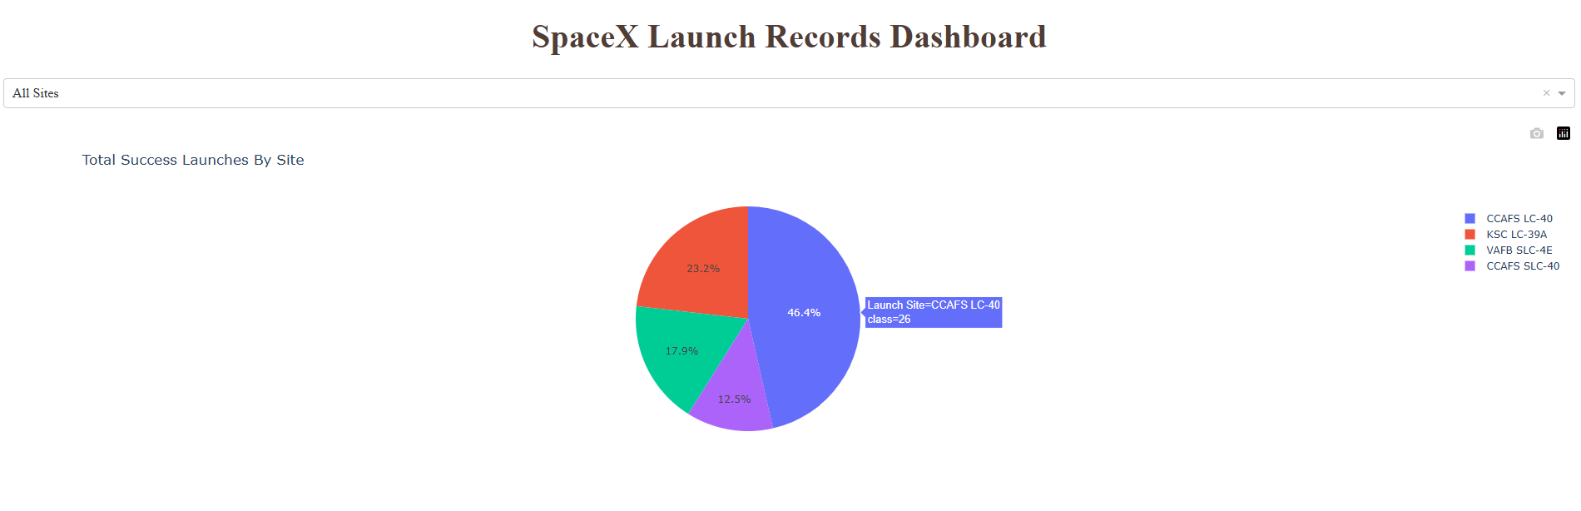
Results
Interactive analytics demo in screenshots

Slide 18
Results
Predictive analysis results
The four models used all gave good accuracy on the data tested,
The model chosen is the Decision Tree which presents a slightly better performance than the three others,

Slide 19

Section 2

Slide 20
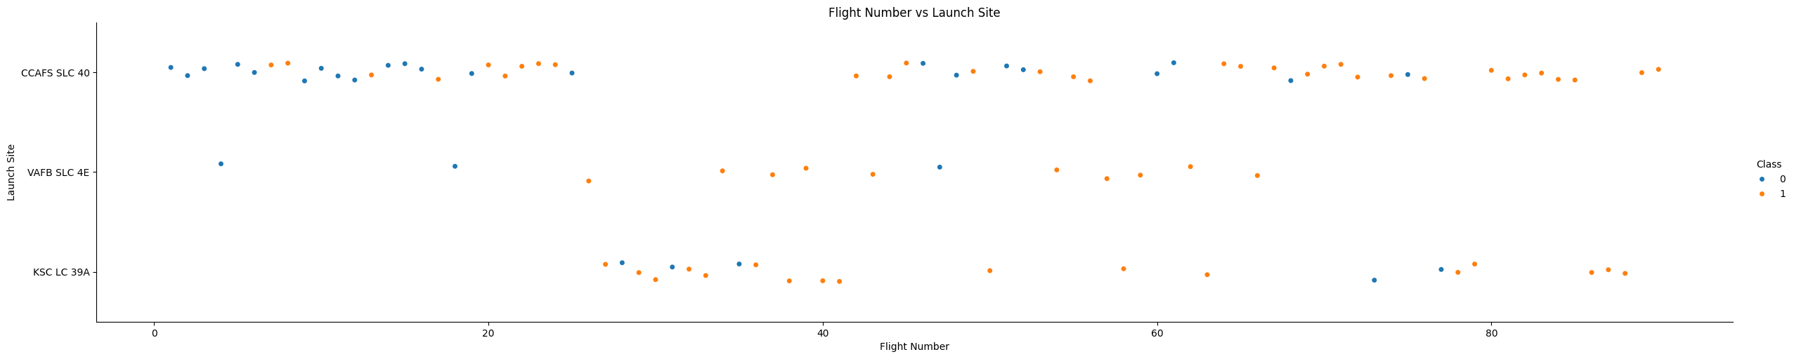
Flight Number vs. Launch Site
Launch site distribution based on Flight Number. The points are colored to correspond to the two landing outcome categories.

Slide 21
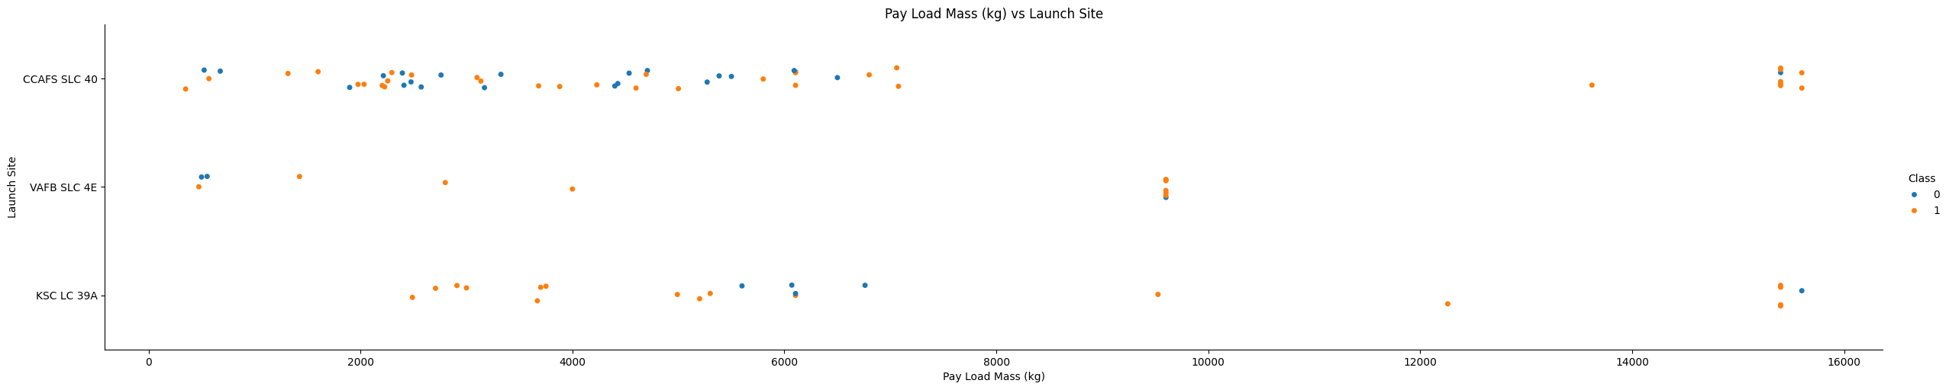
Payload vs. Launch Site
Launch site distribution based on payload mass. The points are colored to correspond to the two categories of landing results.

Slide 22
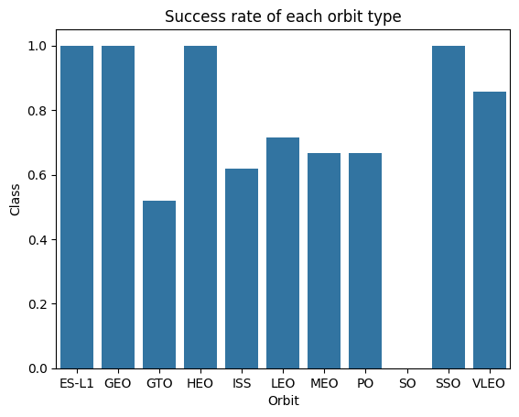
Success Rate vs. Orbit Type
Bar charts showing success rate by orbit type.

Slide 23
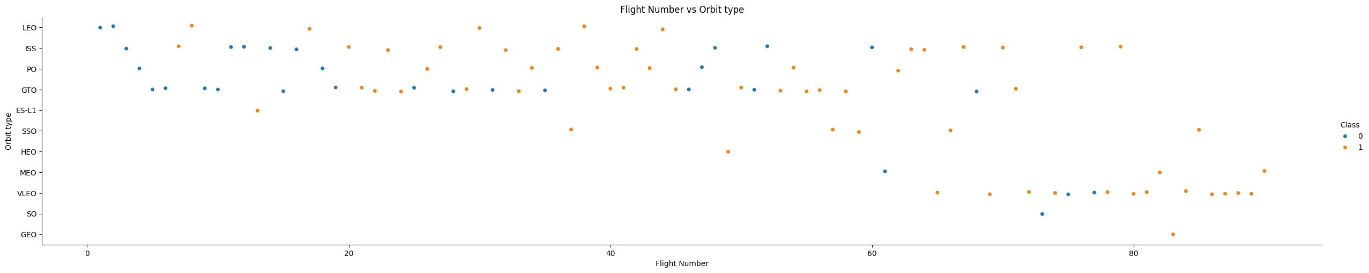
Flight Number vs. Orbit Type
Orbit distribution based on flight number. The points are colored to correspond to the two categories of landing results.

Slide 24
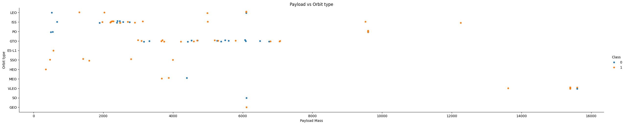
Payload vs. Orbit Type
Orbit distribution based on pay load mass. The points are colored to correspond to the two categories of landing results.

Slide 25
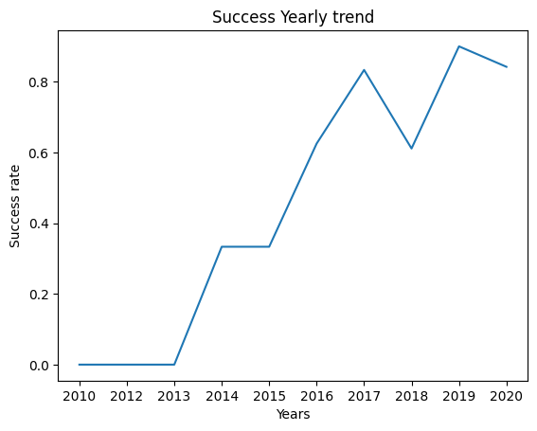
Launch Success Yearly Trend
Graph showing the evolution of the success rate over the years

Slide 26
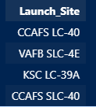
All Launch Site Names
Display of the four launch sites,

Slide 27
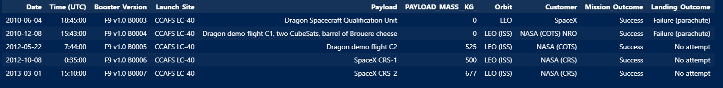
Launch Site Names Begin with 'CCA'
Display of information concerning launch sites whose name begins with 'CCA'.

Slide 28

Total Payload Mass
Total Payload Mass used by NASA (CRS),

Slide 29

Average Payload Mass by F9 v1.1
Average payload mass by the booster version F9 v1.1

Slide 30
First Successful Ground Landing Date
Date, and other useful information on the first successful ground landing date

Slide 31
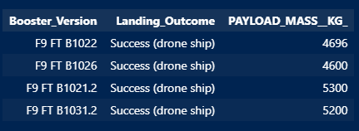
Successful Drone Ship Landing with Payload between 4000 and 6000
Names of boosters which have successfully landed on drone ship and had payload mass greater than 4000 but less than 6000,

Slide 32
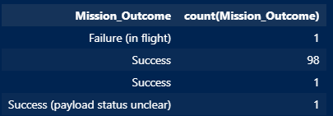
Total Number of Successful and Failure Mission Outcomes
The total number of successful and failure mission outcomes,

Slide 33
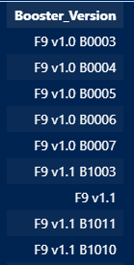
Boosters Carried Maximum Payload
Names of the booster which have carried the maximum payload mass

Slide 34
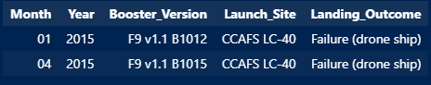
2015 Launch Records
List of the failed landing outcomes in drone ship, their booster versions, and launch site names for in year 2015,

Slide 35
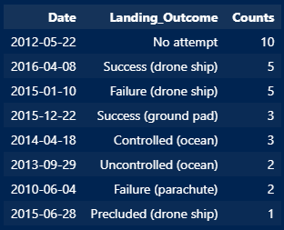
Rank Landing Outcomes Between 2010-06-04 and 2017-03-20
Landing outcomes ranking between the date 2010-06-04 and 2017-03-20.

Slide 36

Section 3

Slide 37
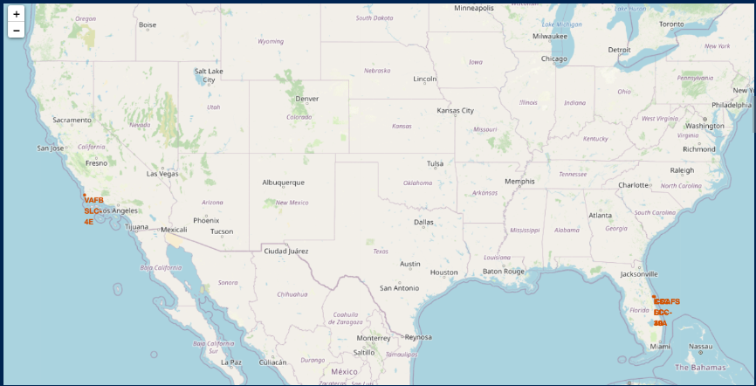
Marked launch sites
Red marking of launch sites

Slide 38
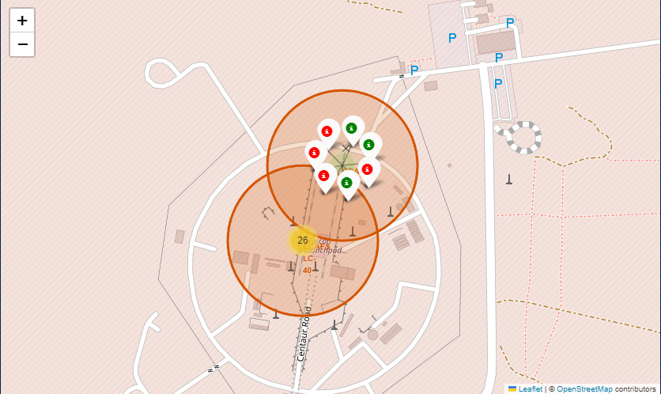
Successful and Unsuccessful landing zones
Marking of successful landing zones in green and unsuccessful landing zones in red.

Slide 39
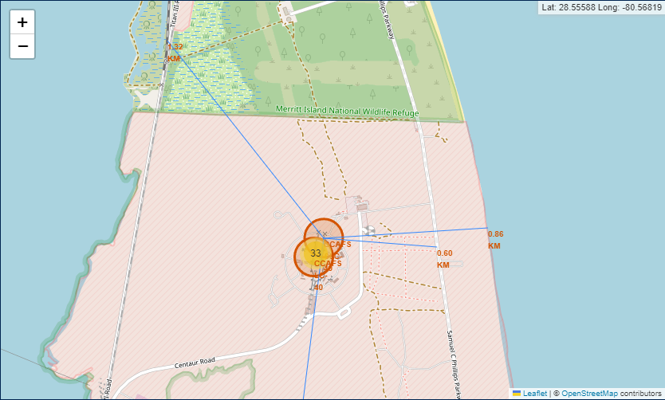
Selected launch site to its proximities
Closest coast, city, railway and highway to the selected launch site.

Slide 40

Section 4

Slide 41
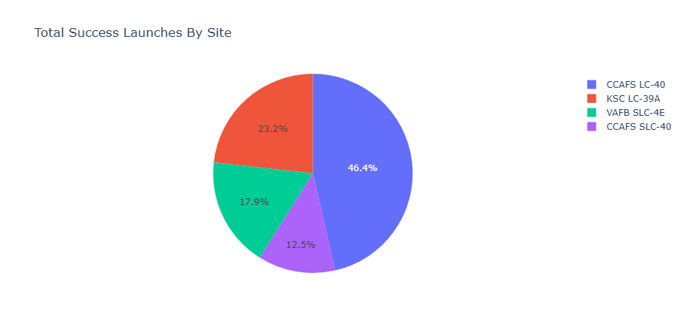
Launch Success for All sites
Rockets launched from the CCAFS LC-40 launch site are among those with the greatest chance of landing successfully, and those from CCAFS SLC-40 have the least success.

Slide 42
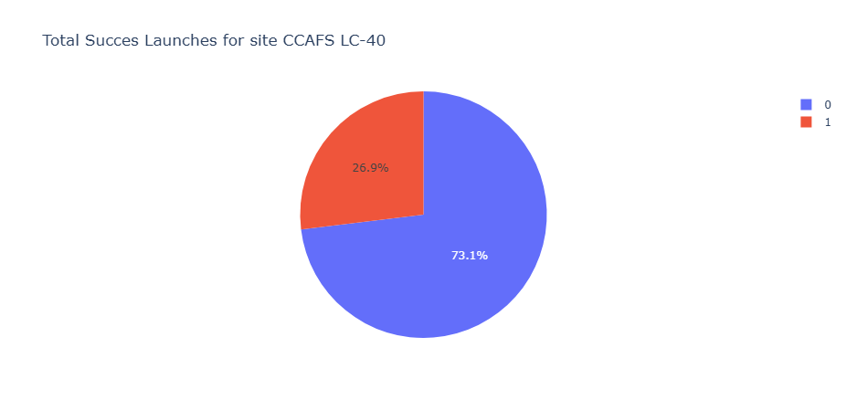
Launch Site with highest launch success ratio
We observe a successful landing rate of 73.1%. Which is relatively encouraging.

Slide 43
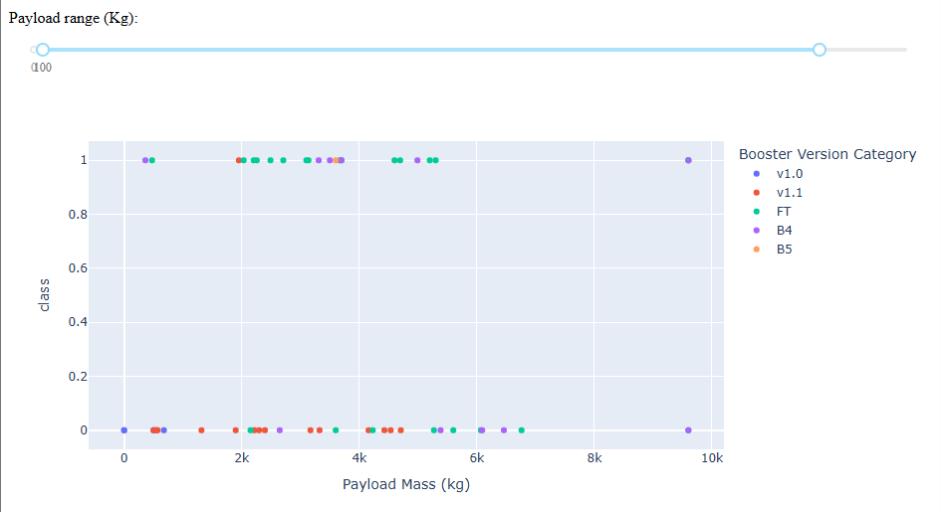
Payload vs Launch Outcome
B5 appears to have the highest success rate, while other versions show mixed results.

Slide 44

Section 5

Slide 45
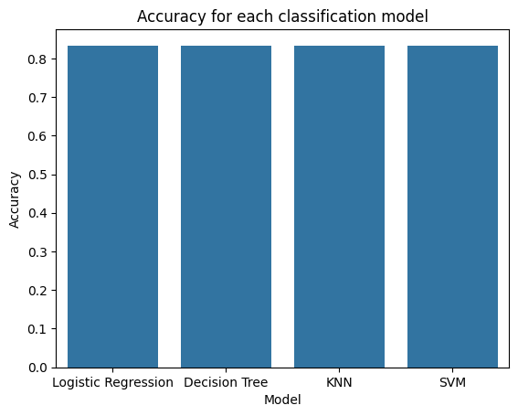
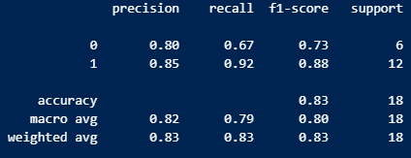
Classification Accuracy
We notice that the Decision Tree model presents the same accuracy as all the other models, but presents a balance in the score of each class. The most efficient model is then the Decision Tree!

Slide 46

Confusion Matrix
Decision Tree Confusion Matrix
High True Positive Rate (11/12): The model has a good ability to correctly predict when a rocket will land, with only one instance misclassified as "did not land.“
Reasonable True Negative Rate (4/6): The model also has a good capability to predict when a rocket will not land, with two instances misclassified as "landed.“
Low Error Rates: The model has relatively low false positive and false negative rates, indicating strong predictive power.
This confusion matrix reflects a model with a high degree of accuracy and balanced performance, particularly in identifying successful landings, which is crucial for predicting cost savings in SpaceX launches.

Slide 47
Conclusions
Our comprehensive analysis of SpaceX launch data has yielded the following key insights:
Landing Success Probability: The probability of a successful landing stands at approximately 67%. This metric underscores the advancements SpaceX has made in its landing technology, yet it also points to areas where improvements can still be made to reach higher consistency.
Optimal Launch Site - CCAFS LC-40: The CCAFS LC-40 launch site emerges as the most reliable option, boasting a significantly higher success rate compared to the other three sites. This finding suggests that CCAFS LC-40 is strategically advantageous for launches, likely due to its infrastructure, location, and operational efficiency. Future missions may benefit from prioritizing this site to maximize the likelihood of successful landings.
Innovative Insights:
Site Selection for Maximized Success: The success rate variation across different launch sites provides a valuable criterion for site selection in future launches. By leveraging this data-driven insight, SpaceX can strategically allocate resources and plan missions to enhance overall mission success.
Data-Driven Decision Making: The use of comprehensive data analytics in evaluating launch outcomes and site performance offers a robust framework for optimizing space missions. This approach not only improves operational efficiency but also contributes to the broader field of aerospace innovation.

Slide 48
Appendix
https://github.com/Tahsine/SpaceX-Capstone.git
https://github.com/Tahsine/SpaceX-Capstone/blob/97105c195ca9cd7264a562e4c0a1bd581e933f9c/spacex_launch_dash.csv
https://github.com/Tahsine/SpaceX-Capstone/blob/97105c195ca9cd7264a562e4c0a1bd581e933f9c/Spacex.csv

Slide 49


